Slide 1
ML - Basic Concepts and Terminologies.

Slide 2
The Dataset
X: Independent Variables/ Input Variables / Feature Variables
y: Dependent Variable/ Output Variable / Response Variable
A dataset might or might not have the y variables, this plays a major role in classifying a ML problem
Training and Test Dataset:
Now that we have a good idea about a ML dataset its important to talk about Training and Test Dataset. A traditional ML model creation process involves breaking the main dataset into 2 parts; Training and Test (usually 70:30).
Once this is done, the training dataset is used to create a ML model whereas the Test dataset is what the model is tested on. This is a very important step and it should always be noted that the testing of a model should always be done on the Test Dataset; i.e. dataset that the Machine Learning model has not seen yet.
More to read: Validation Dataset, Cross Validation.

Slide 3
Categorical vs Numeric Data
Categorical
Numerical
Ordinal
Nominal
1,2,3,4
1.2, 2.3, 4.6, 9.8
3000.343, 3131455.24903
Ex: Age, Price, Credit Score etc
10th, 12th, B.Tech
Small, Medium, Large
Primary, Secondary..
Green, Blue, Red
Cricket, Football, Hockey

Slide 4
Supervised vs Unsupervised
Supervised
Unsupervised
The training dataset has:
X (features)
y (labels)
The training dataset has:
X (features)
and does not have:
y (labels)
Y label
Classification
y is categorical
Predict if a mail is Ham/Spam
Regression
y is Numeric
Ex: Predict price of Land
Clustering

Slide 5
Cost Function
A cost function is how a Machine Learning module decides the best model that fits the dataset. Given the data there are always more than one model that can fit the data, a machine learning algorithm always chooses the ML model that results in minimum cost Function.
Each algorithm has a different criteria to decide what the Cost Function.
Popular Cost Functions:
Mean Squared Error (MSE)
Root Mean Squared Error (RMSE)
Cross Entropy

Slide 6
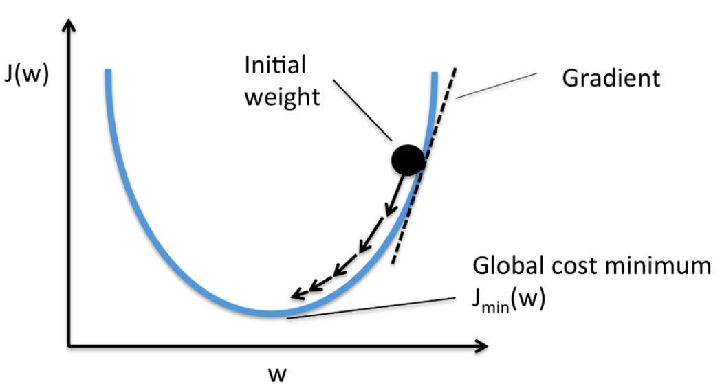
Optimization Algorithms
So we understand that the Cost functions has to be minimized, how do we do this? Ans: Optimization Algorithms
Optimizations Algorithms are various ways available to bring the cost function down.
Popular Algorithms:
Gradient Descent
Stochastic Gradient Descent
AdaGrad
Adam
W = Model Parameters
J(w) = cost function as a function of model parameters.

Slide 7
Model Accuracy
Model Accuracy are parameters that help us decide the accuracy of a model.
It has to be noted that all model accuracy tests should always be conducted on the Test Dataset. The most used parameter is Model Accuracy itself; which is nothing but the % of datapoints that are rightly classified by the model. This however might not be the best parameter all the time, this is where we need to use other parameters.
Example:
Problem Statement: Detect Fraud
Test Dataset: 100 records, 99 no fraud(Class 0), 1 fraud(Class 1).
Model 1:
Predicts all data points as no fraud (all class 0).
Accuracy = Correct/Total %
= 99*100/100 = 99%
Model 2:
Predicts 95 no fraud(class 0) and 1 fraud(Class 1) correctly.
Accuracy 96*100/100 = 96%

Slide 8
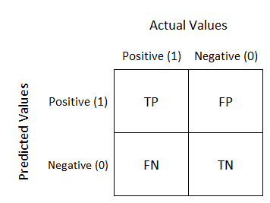
Model Accuracy
Confusion Matrix
Recall or Sensitivity: TP/(TP + FN)
Precision: TP/(TP + FP)
Specificity: TN/(TN+FP)
Other parameters: F1-Recall, AUC-ROC etc.
Model 1:
Recall: 0/0+1 = 0%
0 | 0
1 | 99
Model 2:
Recall: 1/0+1 = 100 %
1 | 4
0 | 95

Slide 9
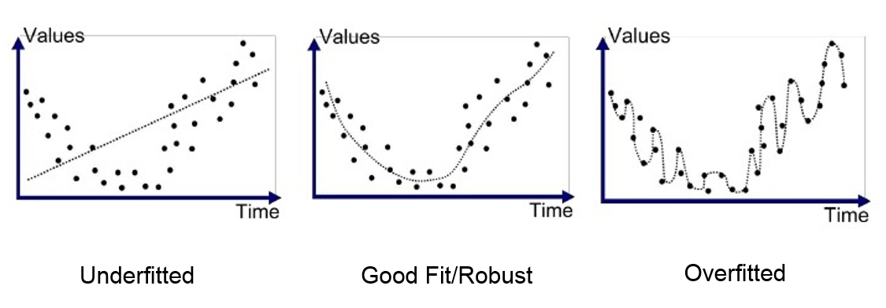
Overfitting and Underfitting

Slide 10
Algorithms

Slide 11
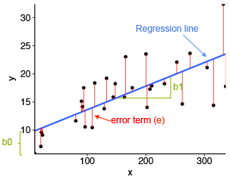
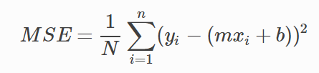
Linear Regression

Slide 12
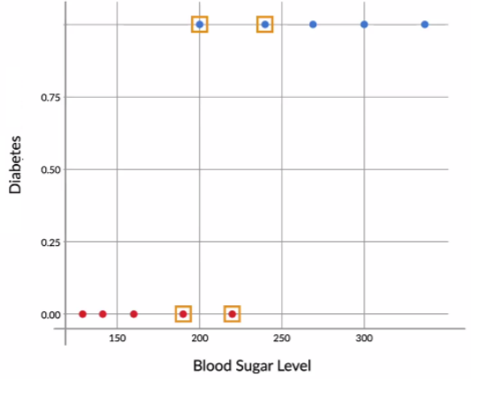
Logistic Regression
Logistic Regression is a supervised classification model. It allows you to make predictions from labelled data, if the target (output) variable is categorical.

Slide 13


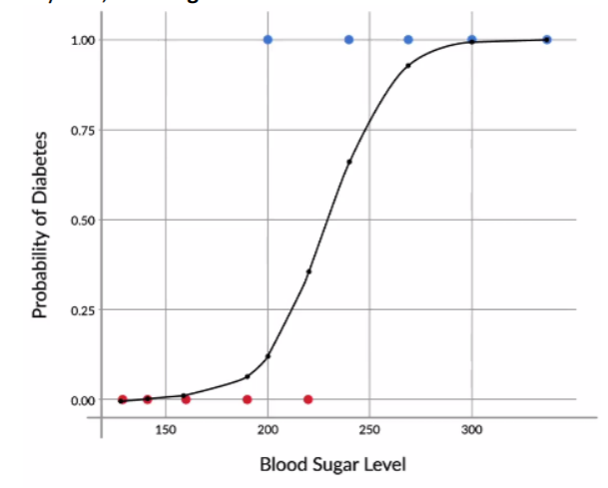
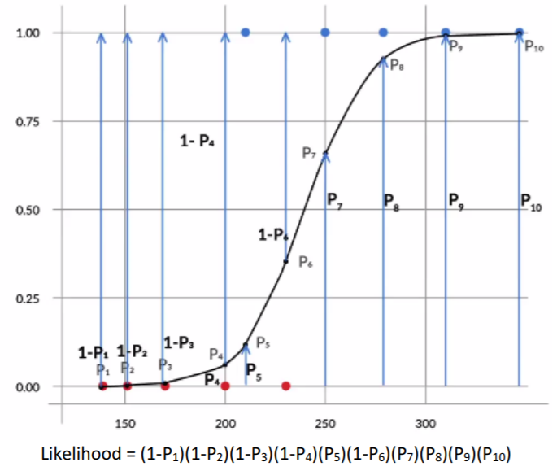
Sigmoid Curve
Concept of Likelihood

Slide 14
Thank You!

